Slide 1

Computer Programming for Engineers
Week 13 Lecture 1
Nov. 22, 2022
Lecturer: Dr. Mohammad Mahdi Javidan
College of Engineering, Sungkyunkwan University
Fall Semester 2022

Slide 2
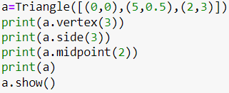
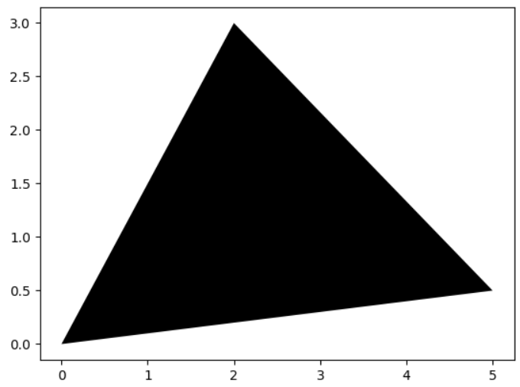

Problem 1
Make the class Triangle which defines a triangle as depicted below.
The object Triangle receives a list of three tuples V which are the coordinates of a triangle vertices.
Methods:
vertex(n) gives the coordinates of the nth vertex
side(n) returns the coordinates of the vertices related to the nth side
midpoint(n) returns the midpoint of the nth side
show(color=‘k’) plots the triangle
__str__() returns the coordinates of vertices as a string
Triangle
Test case
+ V : List
- __init__(V:List)
+ vertex(n)
+ side(n)
+ midpoint(n)
+ show(color:str = ‘k’)
- __str__()
College of Engineering, Sungkyunkwan University

Slide 3

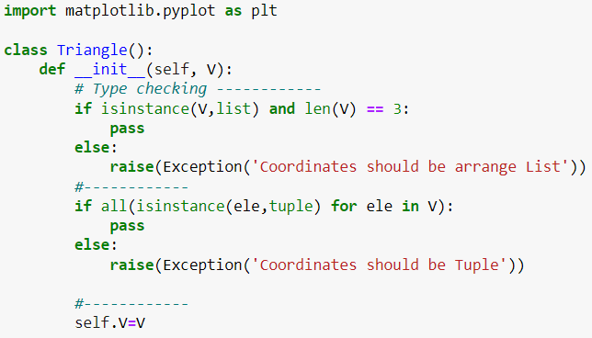
Problem 1
The constructor function
Type checking and number of given coordinates
Functions all() and any()
College of Engineering, Sungkyunkwan University

Slide 4
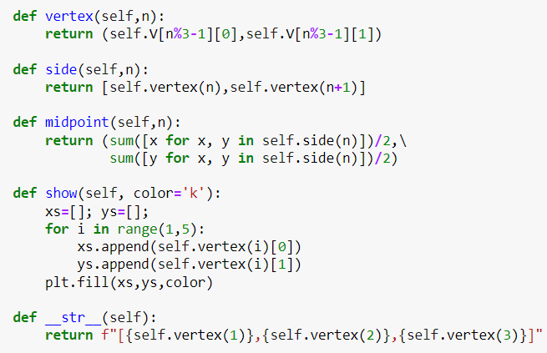
Problem 1
A trick to help in next parts but not necessarily meaningful
List comprehension to make the codes shorter
Using default black color
The function fill() is used for drawing a polygon
College of Engineering, Sungkyunkwan University

Slide 5

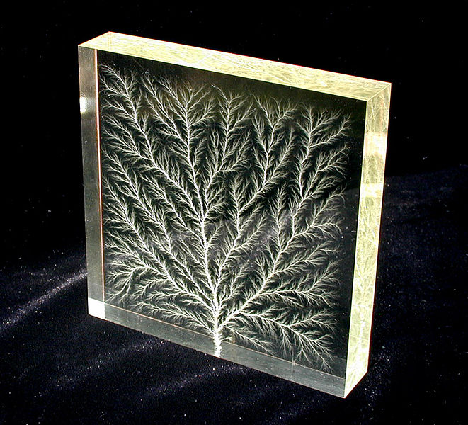
Problem 2
A curve or geometric figure, in which similar patterns recur at progressively smaller scales, and they are useful in modeling and describing partly random or chaotic phenomena such as crystal growth, fluid turbulence, and galaxy formation.
Frost crystals occurring naturally on cold glass
High-voltage breakdown within a 100 mm block of acrylic glass
A Koch snowflake
https://en.wikipedia.org/wiki/Fractal
College of Engineering, Sungkyunkwan University

Slide 6





Problem 2
The Sierpiński triangle is a fractal with the overall shape of an equilateral triangle, subdivided recursively into smaller equilateral triangles. With the help of the class Triangle, write a function Sierpinski_triangle(triangle, n) which receives a Triangle object and constructs the Sierpiński triangle using it after $n$ subdivisions as shown below.
$$n=1$$
$$n=2$$
$$n=3$$
$$n=4$$
College of Engineering, Sungkyunkwan University

Slide 7
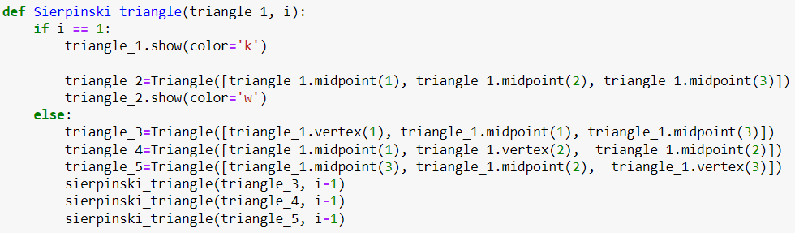
Problem 2
College of Engineering, Sungkyunkwan University

Slide 8
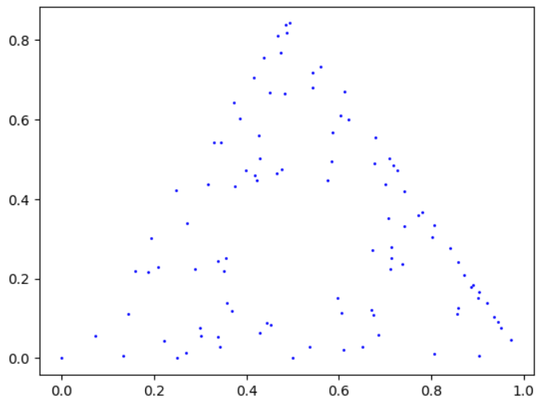
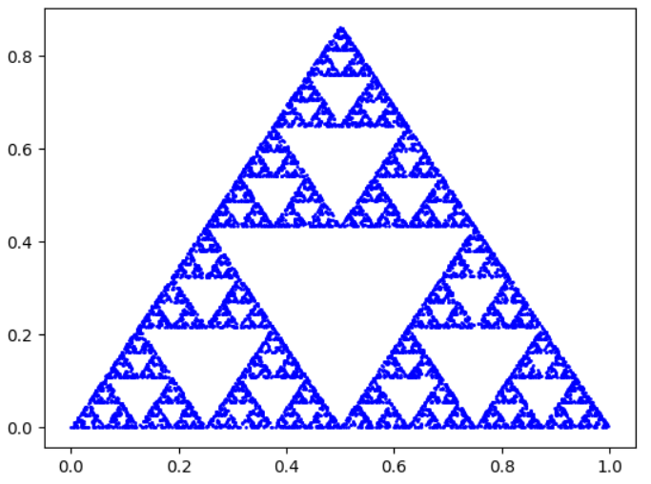
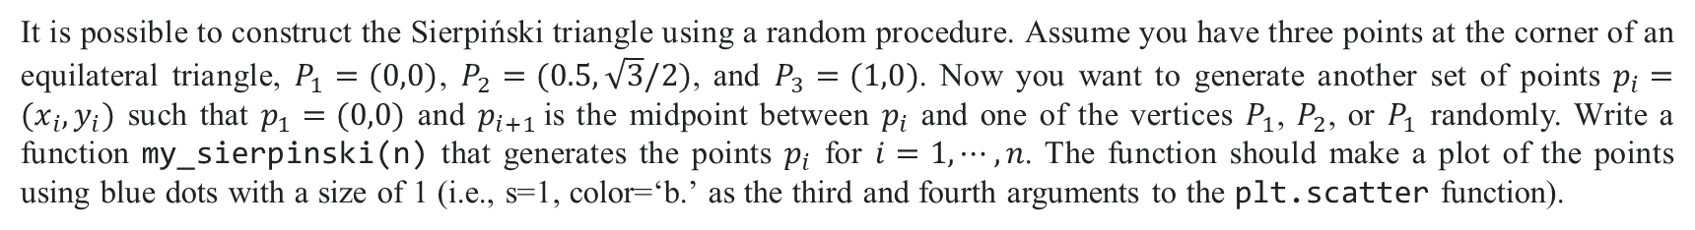


Problem 3
It is possible to construct the Sierpiński triangle using a random procedure. Assume you have three points at the corner of an equilateral triangle, $P_{1}=(0,0)$, $P_{2}=(0.5,\sqrt{3}/2)$, and $P_{3}=(1,0)$. Now you want to generate another set of points $p_{i}=(x_{i},y_{i})$ such that $p_{1}=(0,0)$ and $p_{i+1}$is the midpoint between $p_{i}$ and one of the vertices $P_{1}$, $P_{2}$, or $P_{1}$ randomly. Write a function my_sierpinski(n) that generates the points $p_{i}$ for $i=1,⋯,n$. The function should make a plot of the points using blue dots with a size of 1 (i.e., s=1, color=‘b.’ as the third and fourth arguments to the plt.scatter function).
$$n=100$$
$$n=10000$$
College of Engineering, Sungkyunkwan University

Slide 9
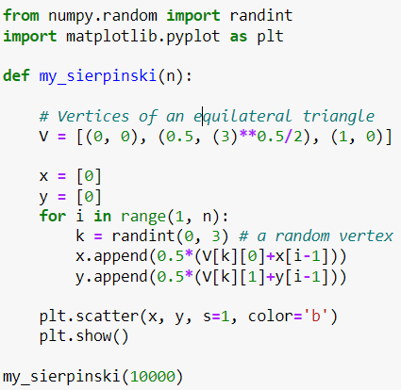
Problem 3
College of Engineering, Sungkyunkwan University

